Slide 1
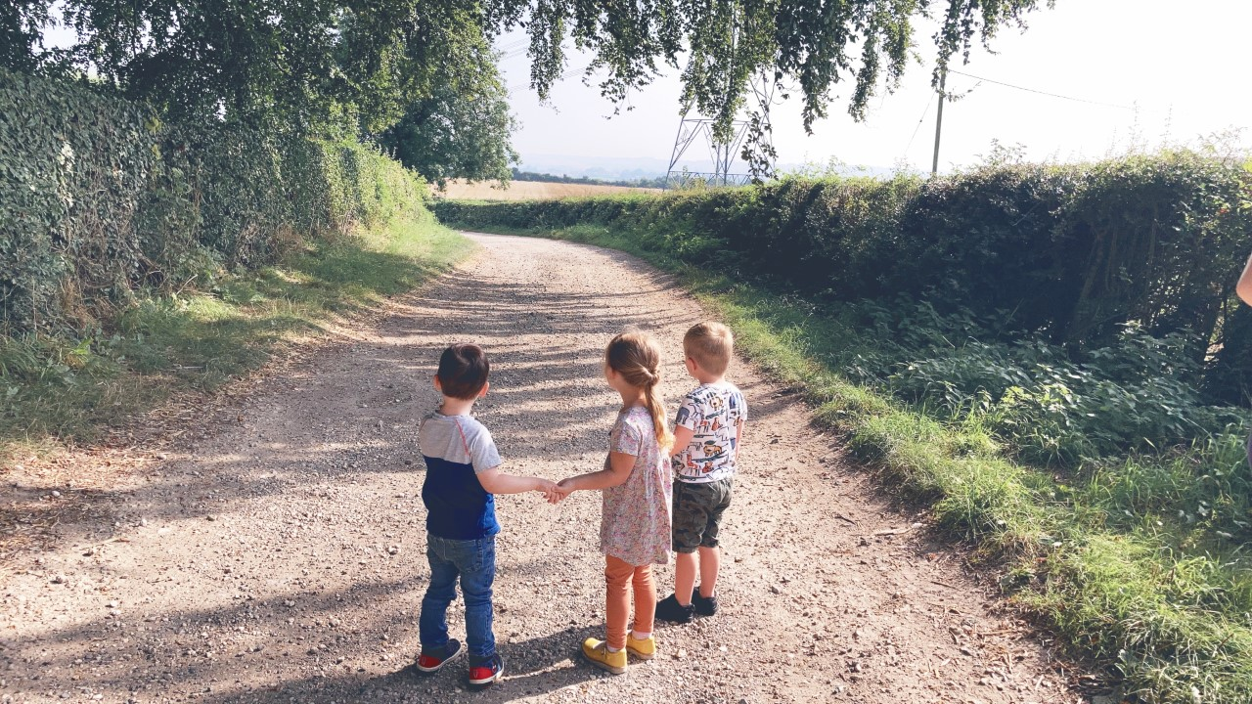
PRE-SCHOOL
WELCOME TO HARES​

Slide 2
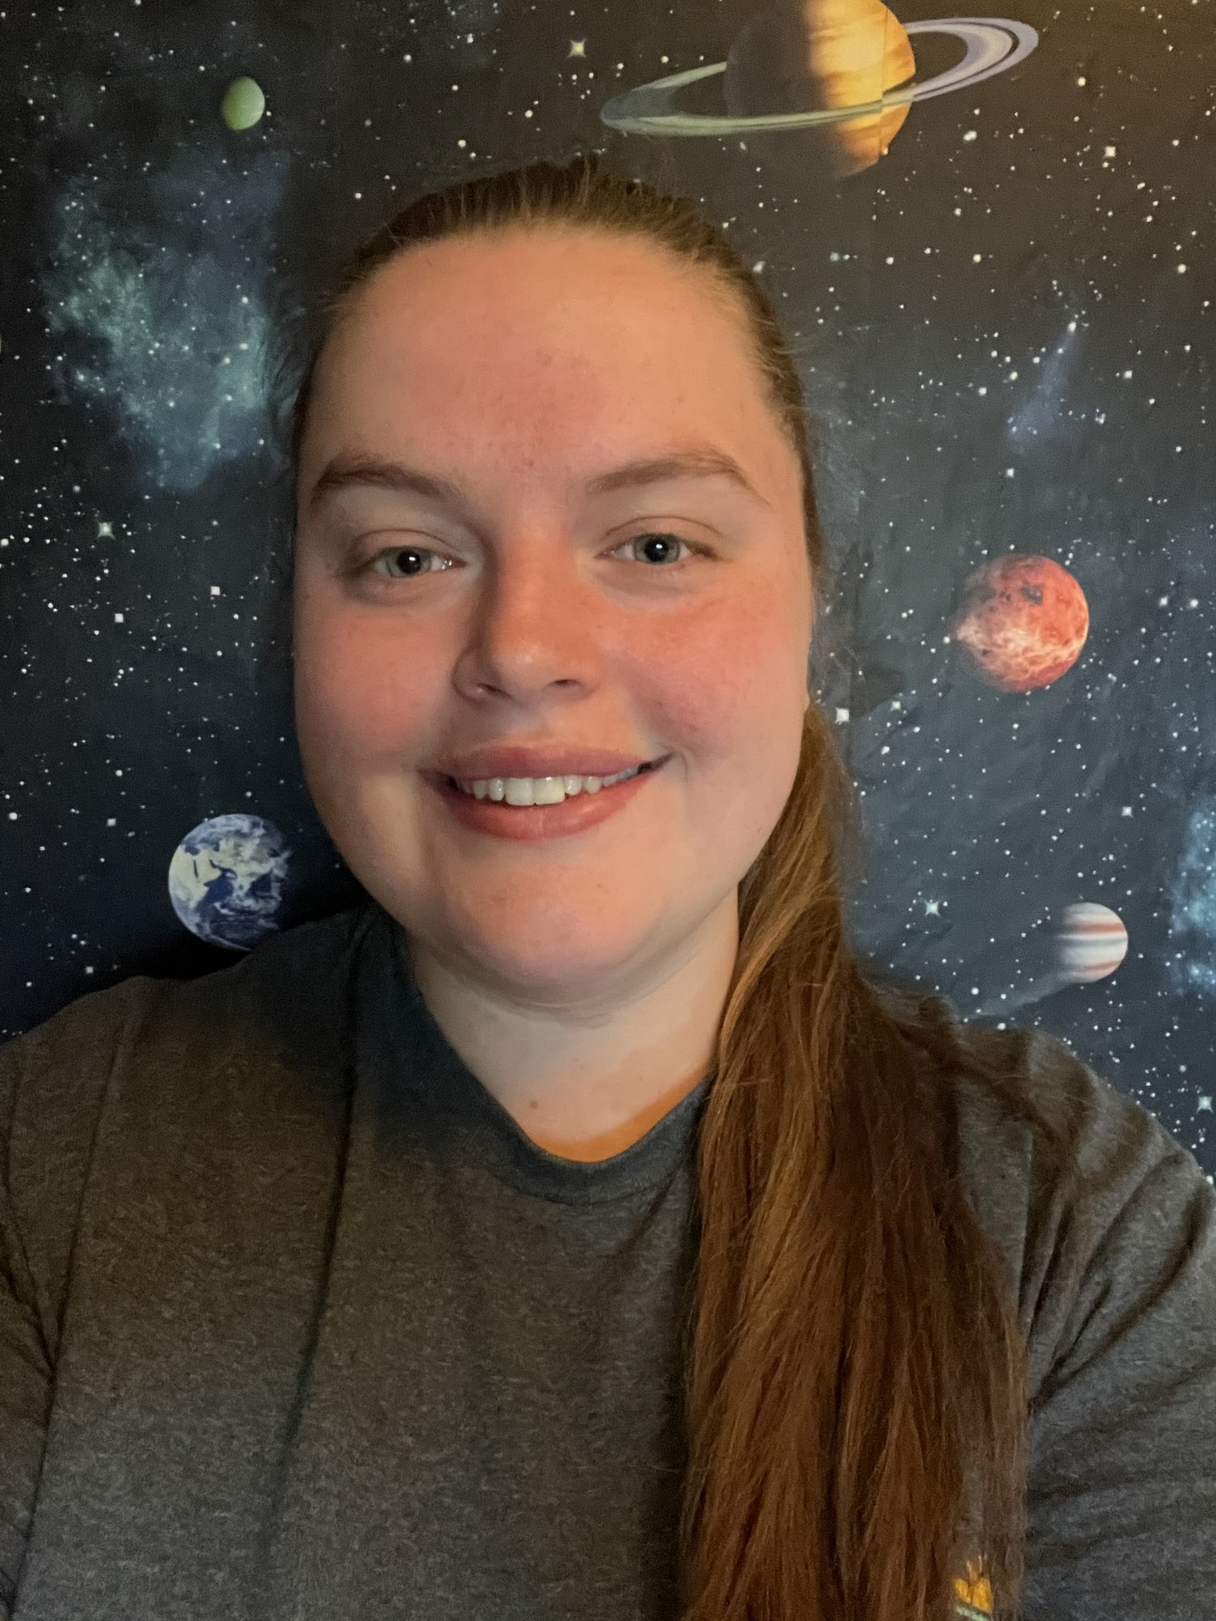


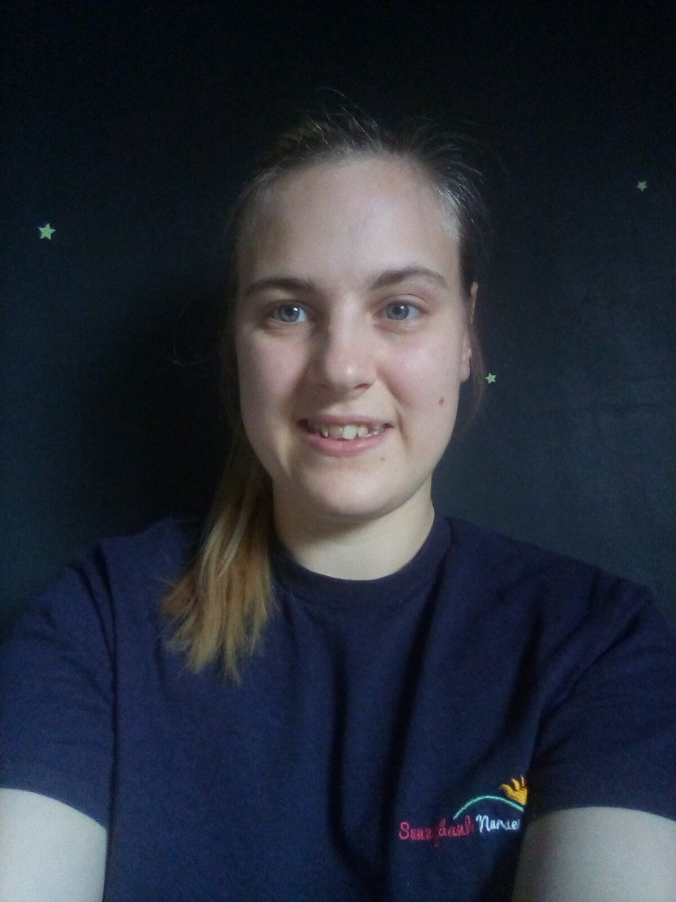
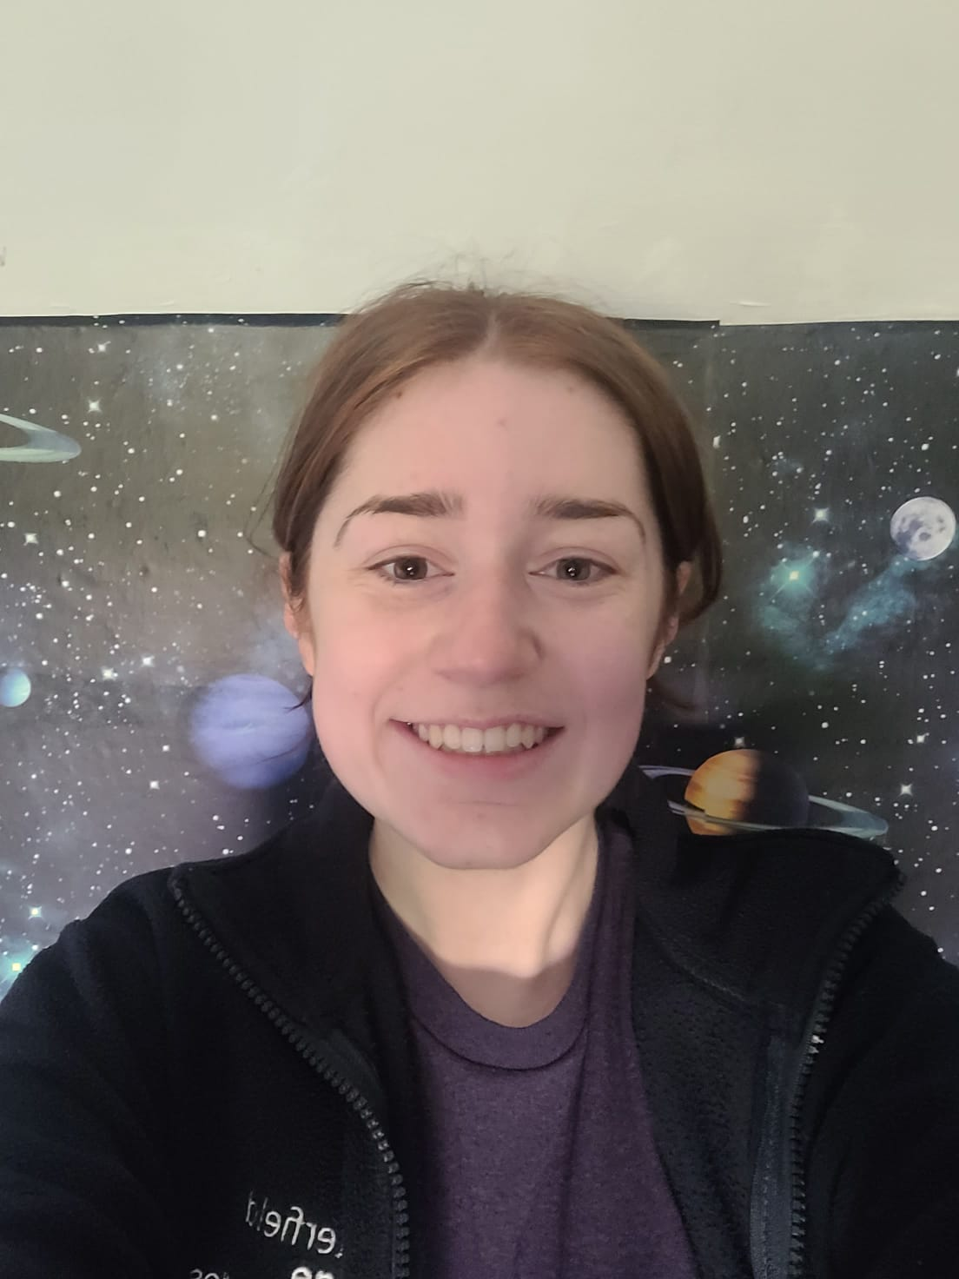
Staff Team
S
IONA – Deputy Manager
Carley – Team Leader
Katie – Early Years Teacher

Slide 3
Introduction
Our preschool room is separate to the main building, providing privacy and independence for our older children. The room has its own bathroom and kitchen facilities and its own free-flow outdoor area. The room provides numerous activities to promote thinking and language skills along with a number of additional curricular activities such as yoga.
The room is staffed 3-5 years 1:8 children
Parent partnerships and being ‘ready for school’ is of particular importance to our pre-school and underpins the planning and activity journey of the group.

Slide 4
Children as Individuals
In Hares, we no longer complete care diaries and instead encourage the children to talk about their meals and toilet routines with you at home.
We incorporate ‘show and tell’ within group times once per week and encourage you to join in with the theme.
Being independent and confident learners is the overall goal for our Hares children in ensuring they are ready for the next step. We encourage independence through serving meals, activity choice, flexible routines and much more.

Slide 5
Assessment Schedule
A
OBSERVATIONS
We will continue to observe children weekly and these will be posted to your child’s journal.
ASSESSMENTS
Your child will receive a written report at the end of each term via Tapestry.
PARENTS EVENINGS
Parents evenings will also be held at the end of each term to discuss your child’s progress and next steps. However, please do not feel the need to wait for these appointments, we encourage an ‘open door’ policy and are happy to discuss your child’s development each session.

Slide 6
Drop off and pick up
D
During drop off and pick up times, we kindly ask that you ring the doorbell and wait at the door while we get your child ready. This helps us ensure the safety of all children in the setting. Thank you for your understanding.

Slide 7
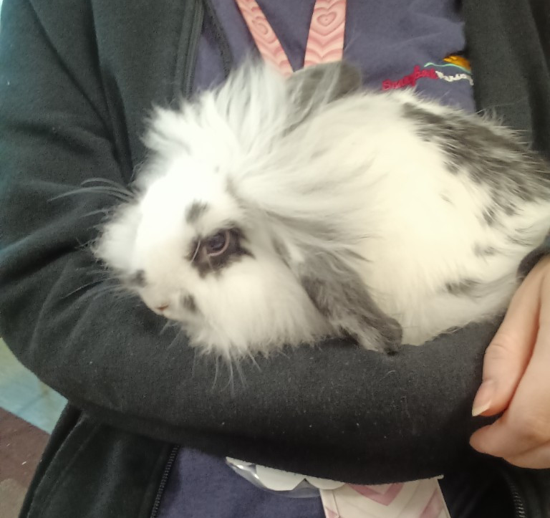
Dotty the Rabbit
In Hares, we have a pet rabbit called Dotty. The children love helping to care for her by making sure she has plenty of food and fresh water. They also enjoy spending time with Dotty, gently stroking her and learning how to be kind and caring towards animals.

Slide 8
Important Information

Slide 9
Curriculum
We use the new Statutory Framework for the Early Years Foundation Stage (September 2021), along with the Development Matters guidance to support our curriculum planning. The curriculum is a broad and varying mixture of approaches (including but not limited to Elizabeth Jarmans Communication Friendly Spaces, HYGGE in the Early Years, Reggio, Montessori, Outdoor Learning and Forest Schooling), allowing us to tailor our approach for every child to allow them to reach their full potential.

Slide 10
Busy books
B
In Hares, we use ‘busy books’ to continue learning from nursery to home. These are sent home each month with an activity for you to complete with your little one.

Slide 11
 | Autumn 1 | Autumn 2 | Spring 1 | Spring 2 | Summer 1 | Summer 2
Predictable Interests NB These themes will be adapted to allow children’s interests to underpin planning. | New Beginnings Superheroes People who help us Food Being kind / staying safe | Traditional Tales Our favourites Familiar tales Library visits Letters to Father Christmas | Animals around the world Down on the Farm Mini Beasts Animal patterns Dinosaurs and fossils | Plants & Flowers Weather / seasons The Sun and Moon Forest School Planting seeds Reduce, Reuse & Recycle Fun Science / Materials | Around the Town Fly me to the moon! Vehicles | Under the sea Off on holiday Send me a postcard! Seaside art
Possible Texts or Rhymes | Owl Babies Stick Man The Smartest Giant Rainbow Fish Big Book of Families | Goldilocks Farmer Duck The Ugly Duckling Christmas Story | The Very Hungry Caterpillar Tiger Who Came to Tea Pig in the Pond | Supertato Oliver’s Vegetables Jack and the Beanstalk Jasper’s Beanstalk | Snail and the Whale Bob, The Man on the Moon | Lighthouse Keepers Lunch Tiddler World Atlases
Enrichment Opportunities | Autumn Trail Fire Station Visit Harvest Festival Halloween | Bonfire Night Christmas Diwali Remembrance day Children in Need | Zoo Lab Chinese New Year Valentines Day | Trips Easter Mothers Day | Road Safety Post a Letter Food tasting | World Space Week Fathers Day Pirate Day

Slide 12

Phonics Phase 1
Jolly Phonics is a comprehensive programme, based on the proven, fun and muliti-sensory synthetic phonics method that gets children reading and writing from an early age. This means that we teach letter sounds as opposed to the alphabet. These 42 letter sounds are phonic building blocks that children, with the right tools, use to decode the English language. When reading a word, they recognise the letters and blend together the respective sounds; when writing a word they identify the sounds and write down the corresponding letters. These skills are called blending and segmenting. These are two of the five skills that children need to master phonics:

Slide 13
Daily Routine
Each day in pre-school is different to the last and we place emphasis on following children’s individual needs and routines as well as their interests and next steps. However, a sample day in Hares would follow:
7:00 - 9:30 breakfast and free play
9:30 - 10:00 group time and singing/toothbrushing
10:00 - 10:30 rolling snack available
10:30 - 11:15 outdoor
11:30 - 12:30 lunch time
12:30 - 1:30 - rest and free play activities
1:30- 2:00 – group time and story time
2:00 - 2:30 snack
2:30 - 3.15 outdoor
3:30 - 4:00 tea time
4:00 – 6:00 outdoor/free play

Slide 14
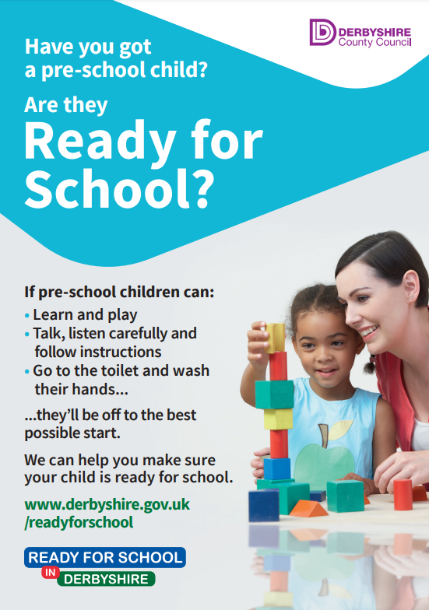
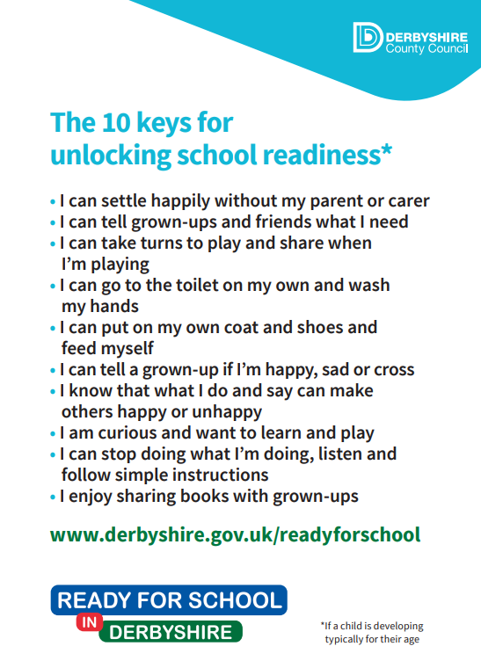
10 Keys to School Readiness

Slide 15
Parent Partnerships
P
We value greatly the relationships we have with our families and this doesn’t change in pre-school. We hold lots of curricular activities that you are invited to join in with including sports days, visits in the local community, Forest schools, Nativity and much more.
Equally we value and support your input in your child’s journey at Sunnybank, so any ideas you may have are appreciated and welcomed.
Please keep an eye out for information on these events on monthly newsletters and join us where you can!

Slide 16
Forest Schools
Forest schools gives the children the opportunity to learn and explore in a natural outdoor environment. Through hands-on experiences, children build confidence, independence and resilience. It supports physical development through climbing, balancing and movement whilst also encouraging curiosity, creativity and problem solving. Time spent outdoors helps children develop a love for nature, supports emotional well-being and promotes teamwork, communication and social skills.
Forest schools does take place in all weathers so suitable clothing is essential. You should bring:
-Waterproof coat
-Waterproof trousers/ all in one
-Wellies
-Warm layers (fleece/jumper, hat, gloves in the colder months)
-Sun hat and sun cream in warmer weathers
-Spare clothes

Slide 17

Useful Resources
https://www.bbc.co.uk/tiny-happy-people
https://hungrylittleminds.campaign.gov.uk/
https://www.twinkl.co.uk/
https://www.derbyshire.gov.uk/leisure/libraries/find-your-local-library/chesterfield-library.aspx
https://foundationyears.org.uk/files/2015/03/4Children_ParentsGuide_2015_WEB.pdf
https://www.localoffer.derbyshire.gov.uk/home.aspx
https://abcdoes.com/
https://www.gov.uk/government/publications/development-matters--2

Slide 18
Thank you
SUNNYBANK NURSERY
07704884344
Officeteam.sunnybankdaynursery@gmail.com

