Slide 1
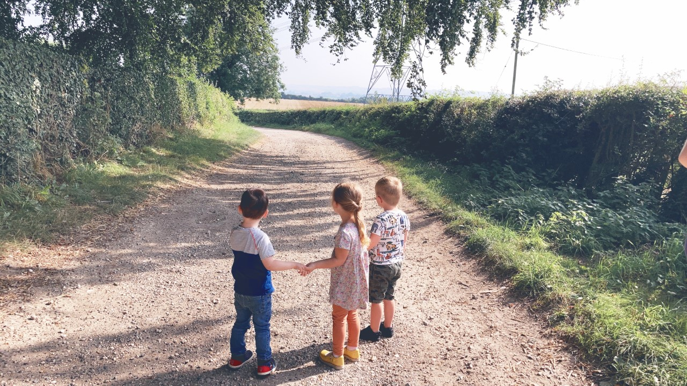
BABIES, MINIS AND RABBITS
WELCOME TO MAIN NURSERY

Slide 2
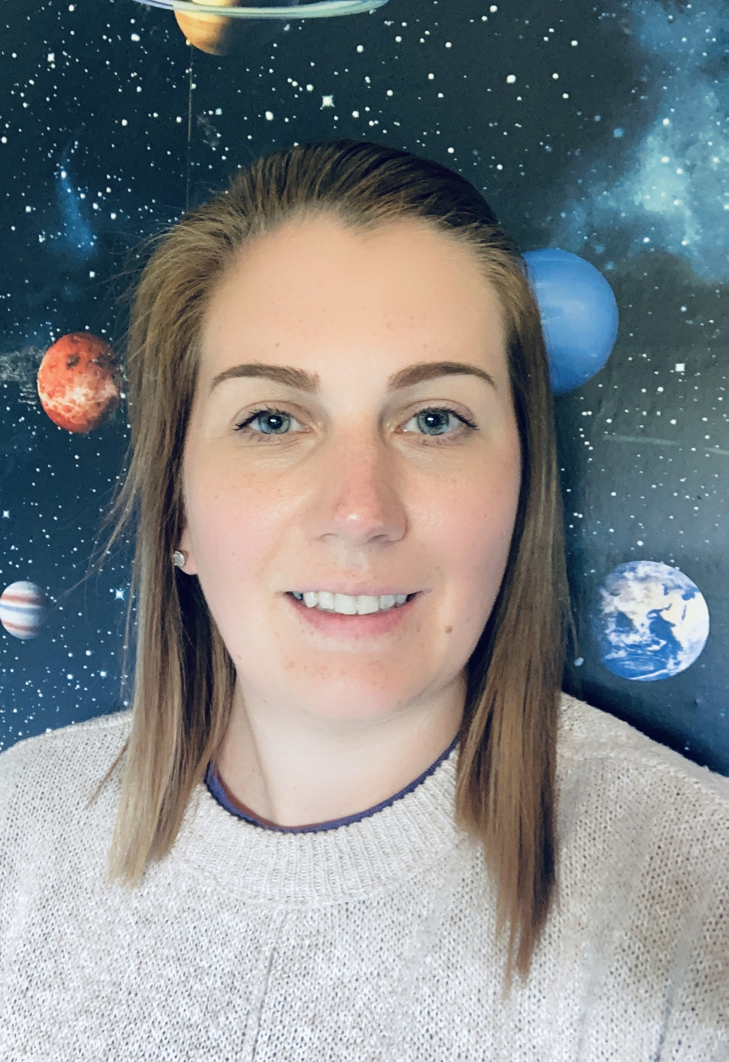



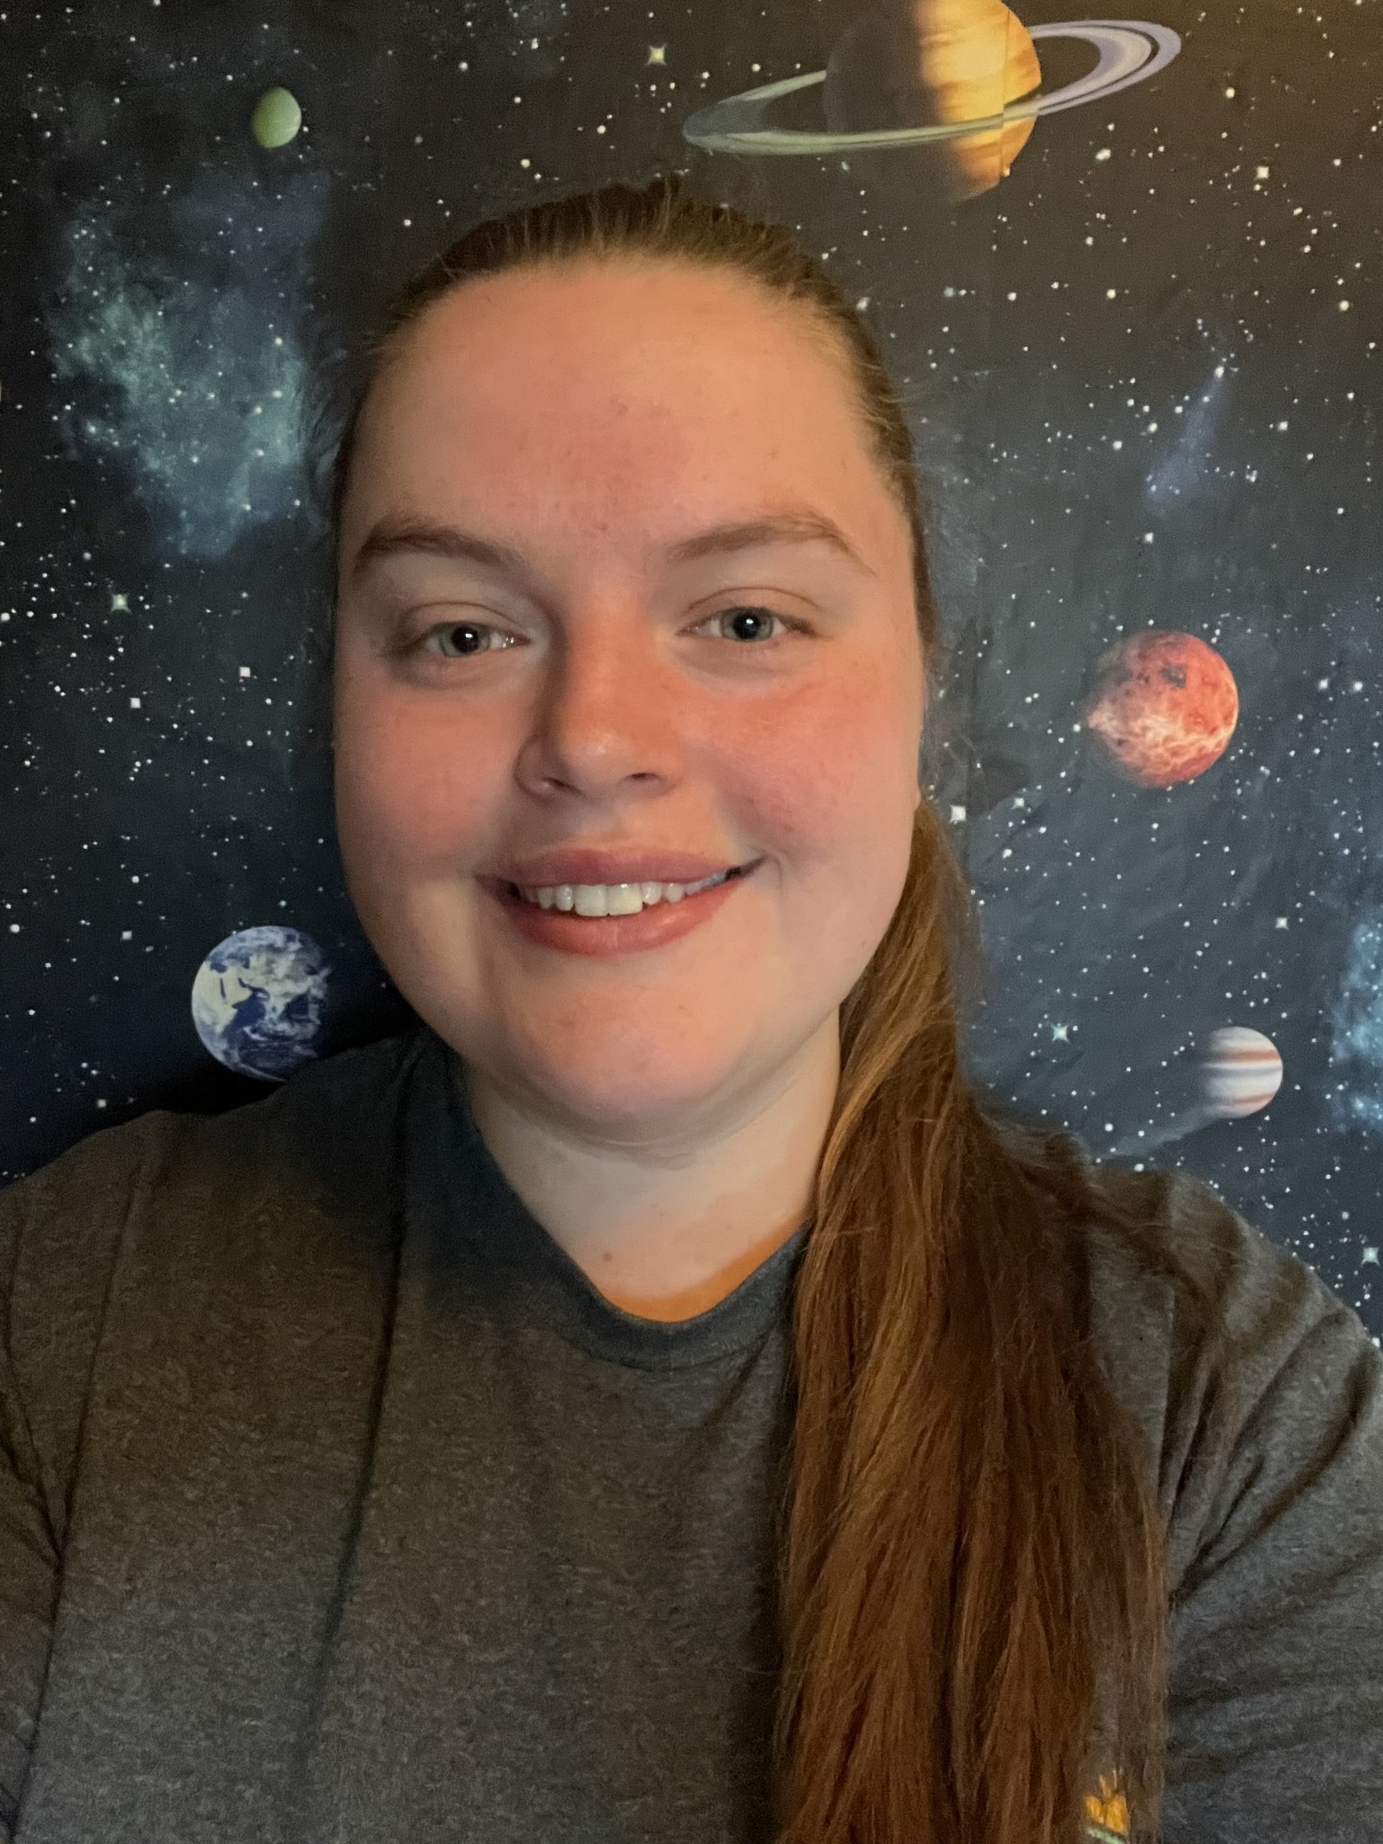
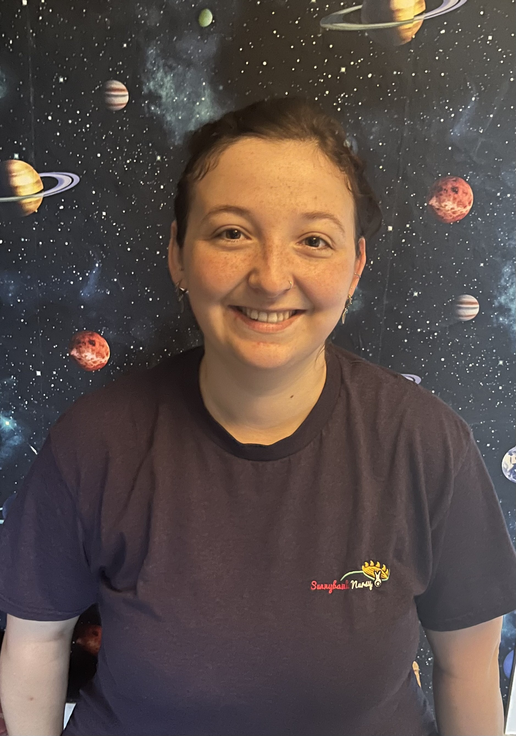
Management Team
S
Christine – Manager
Gemma – Under 3’s Deputy Manager
Iona – Over 3’s Deputy Manager
Claire – Officer in Charge

Slide 3
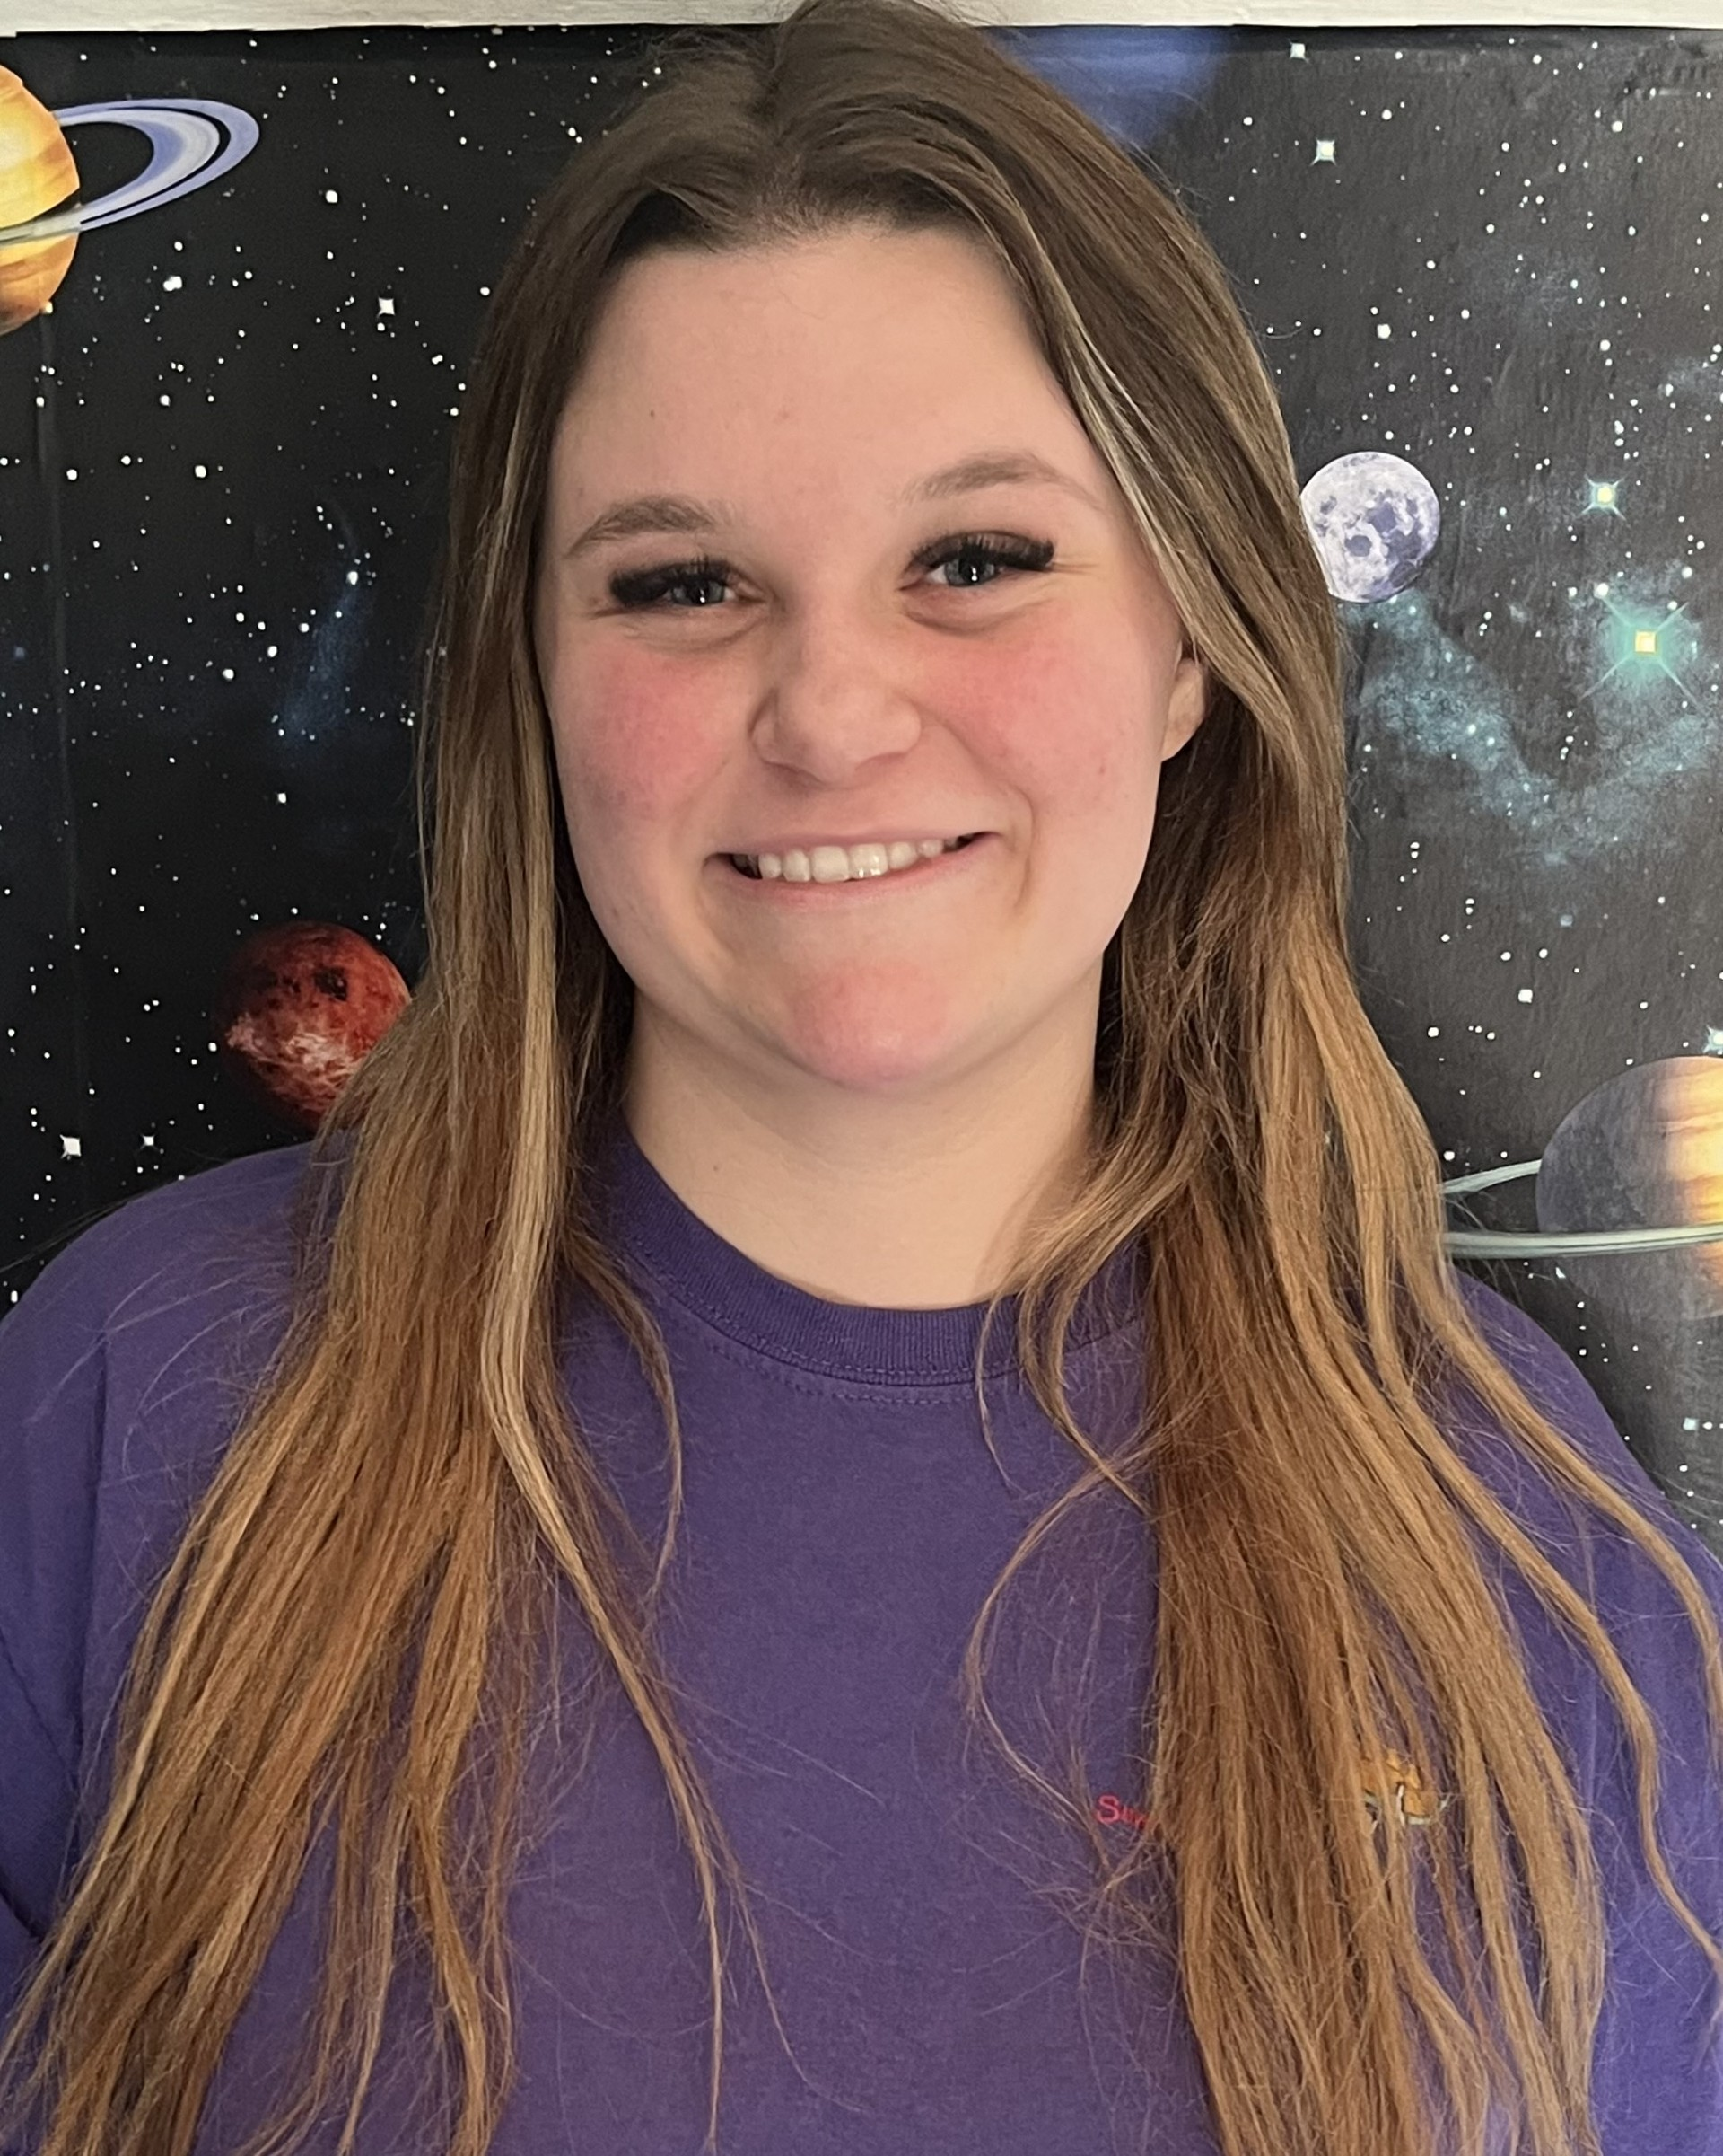
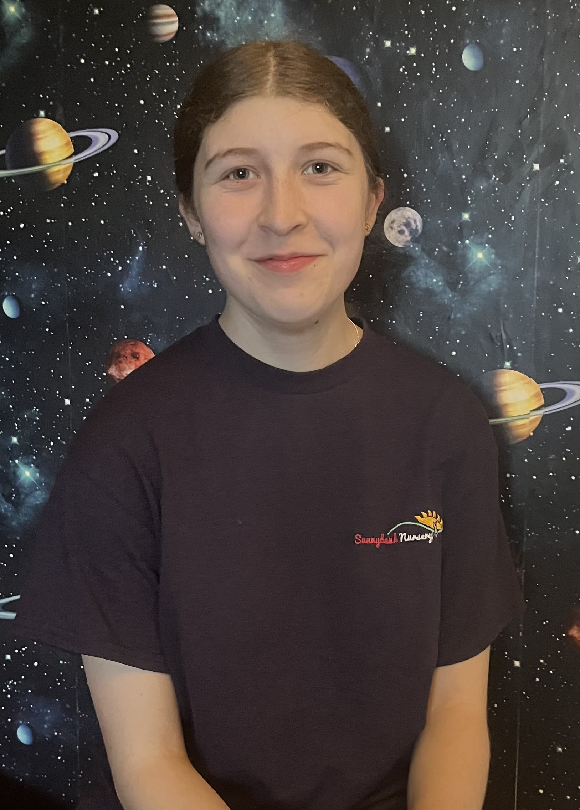
Staff Team - Babies
S
Jess – Team Leader
Bethany – Practitioner

Slide 4
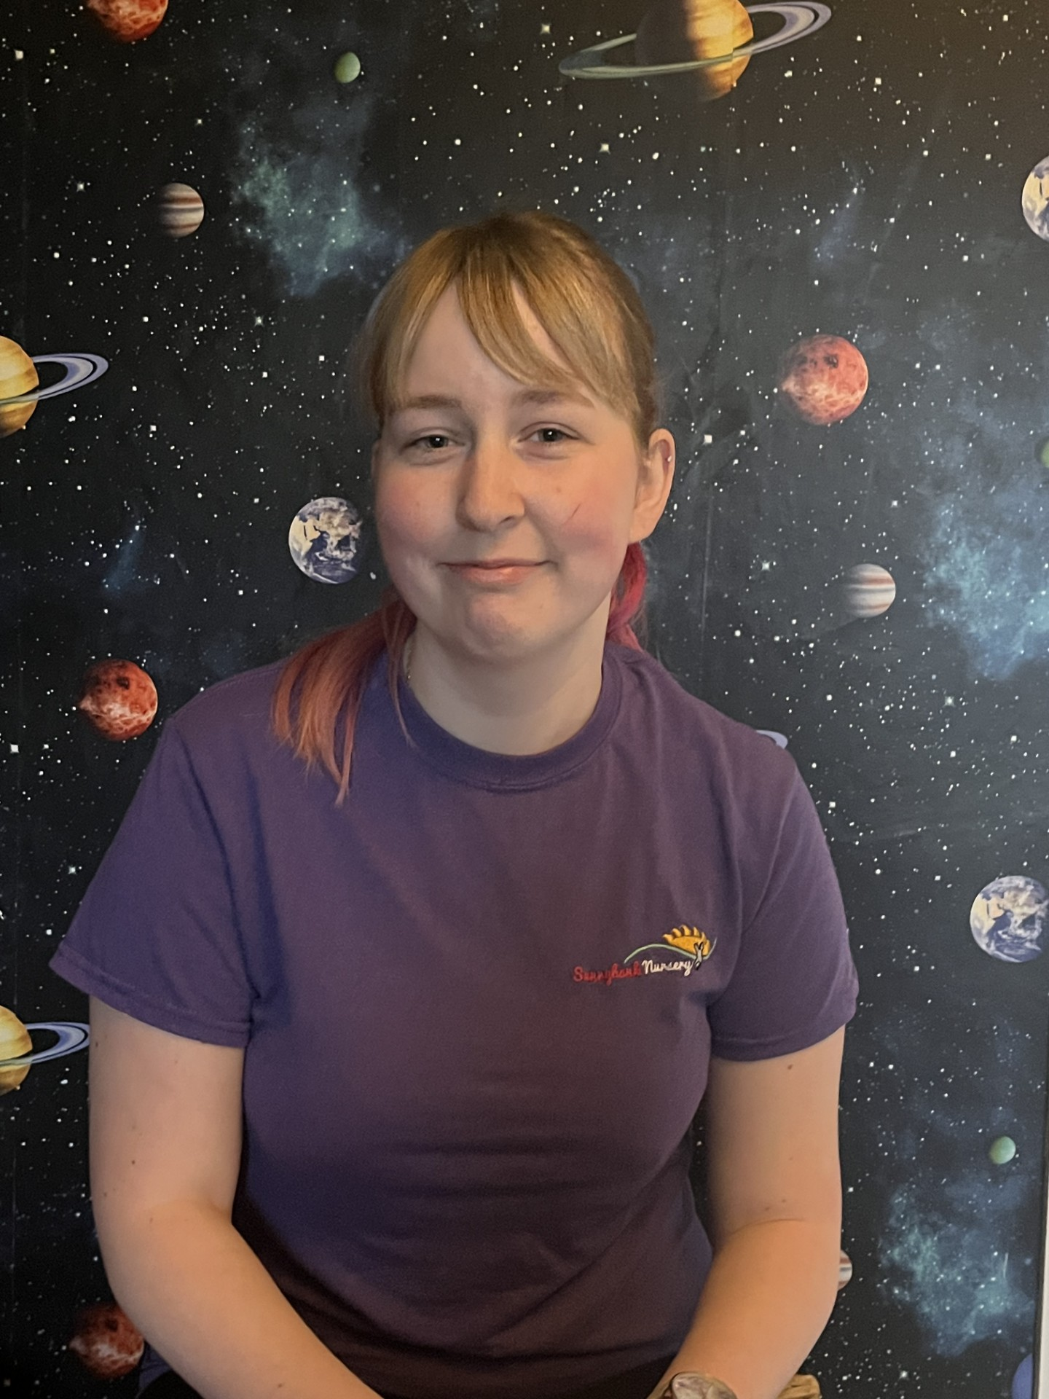
Staff Team - Minis
S
Claire – Team Leader
Hollie – Practitioner

Slide 5
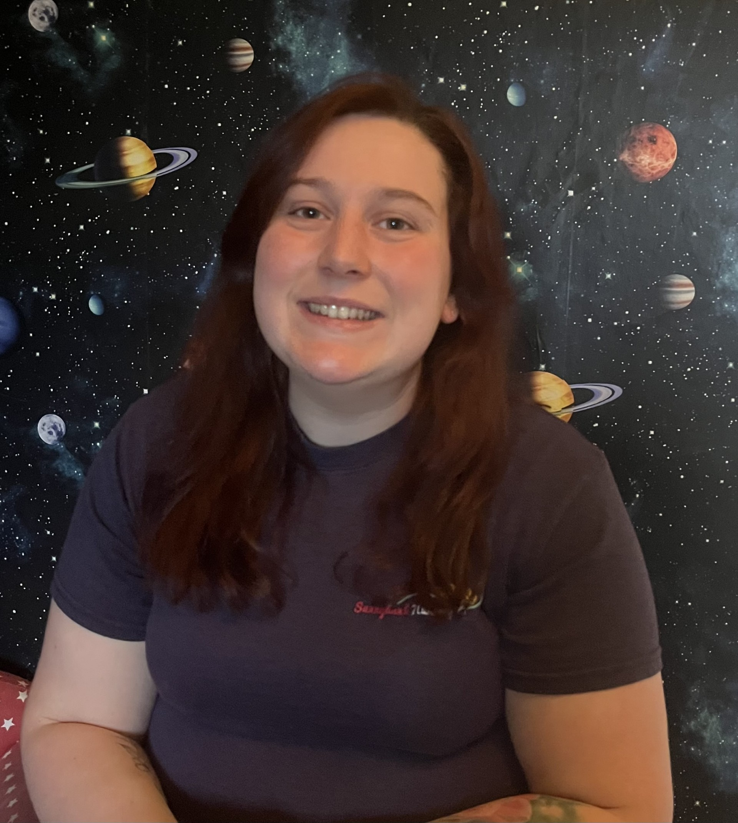
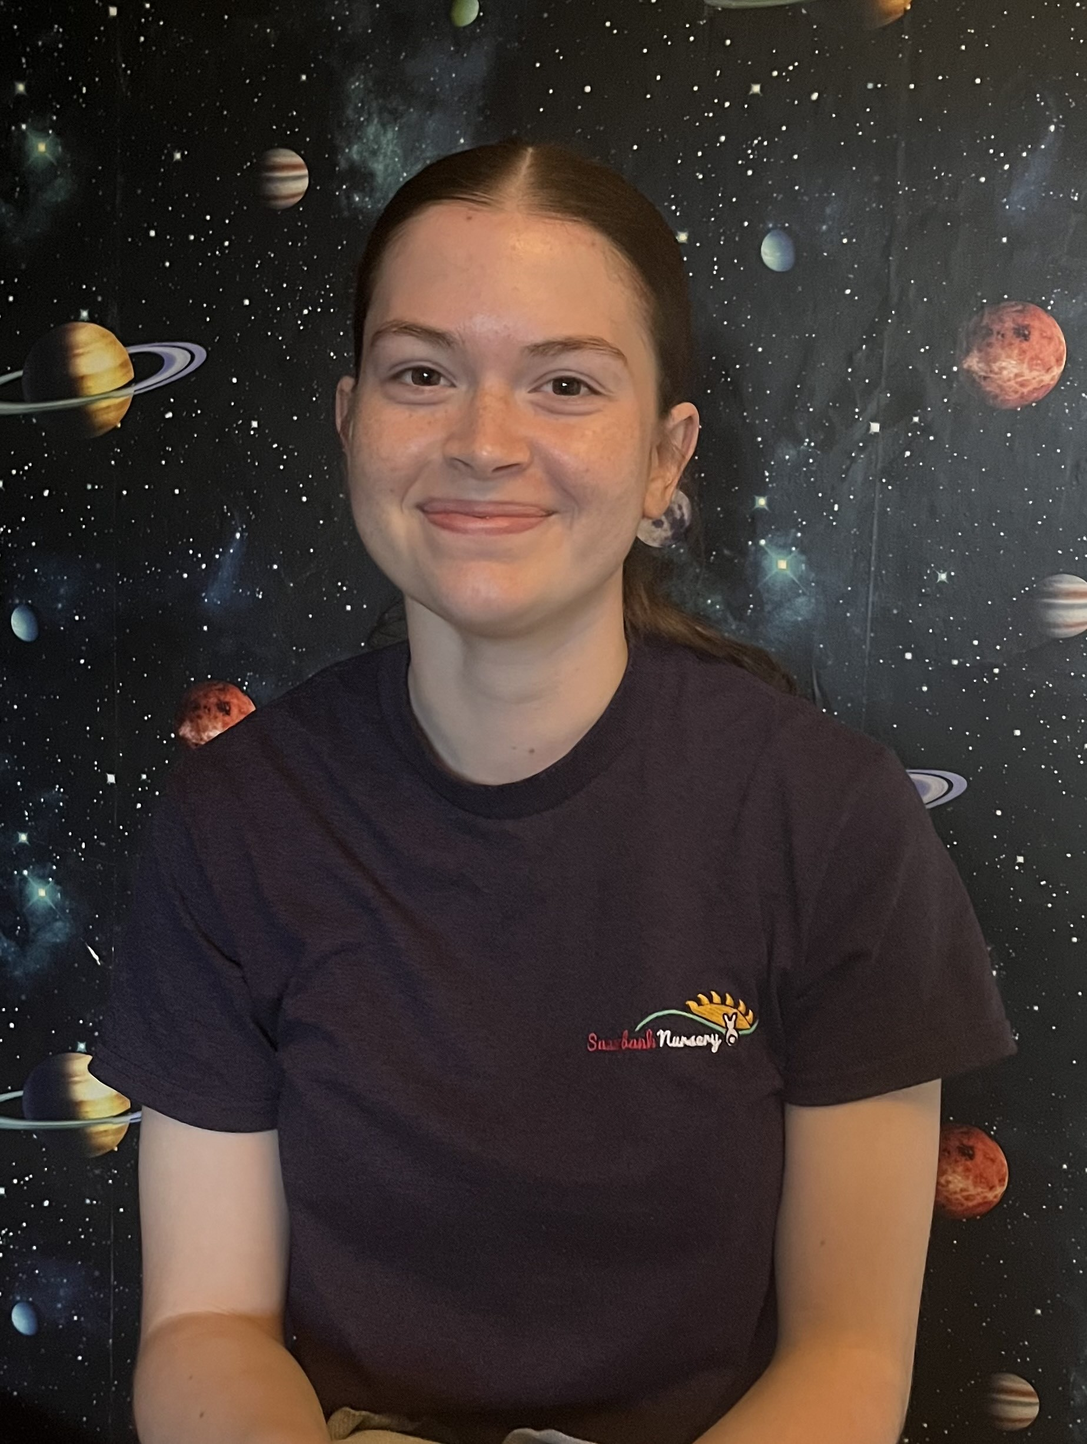
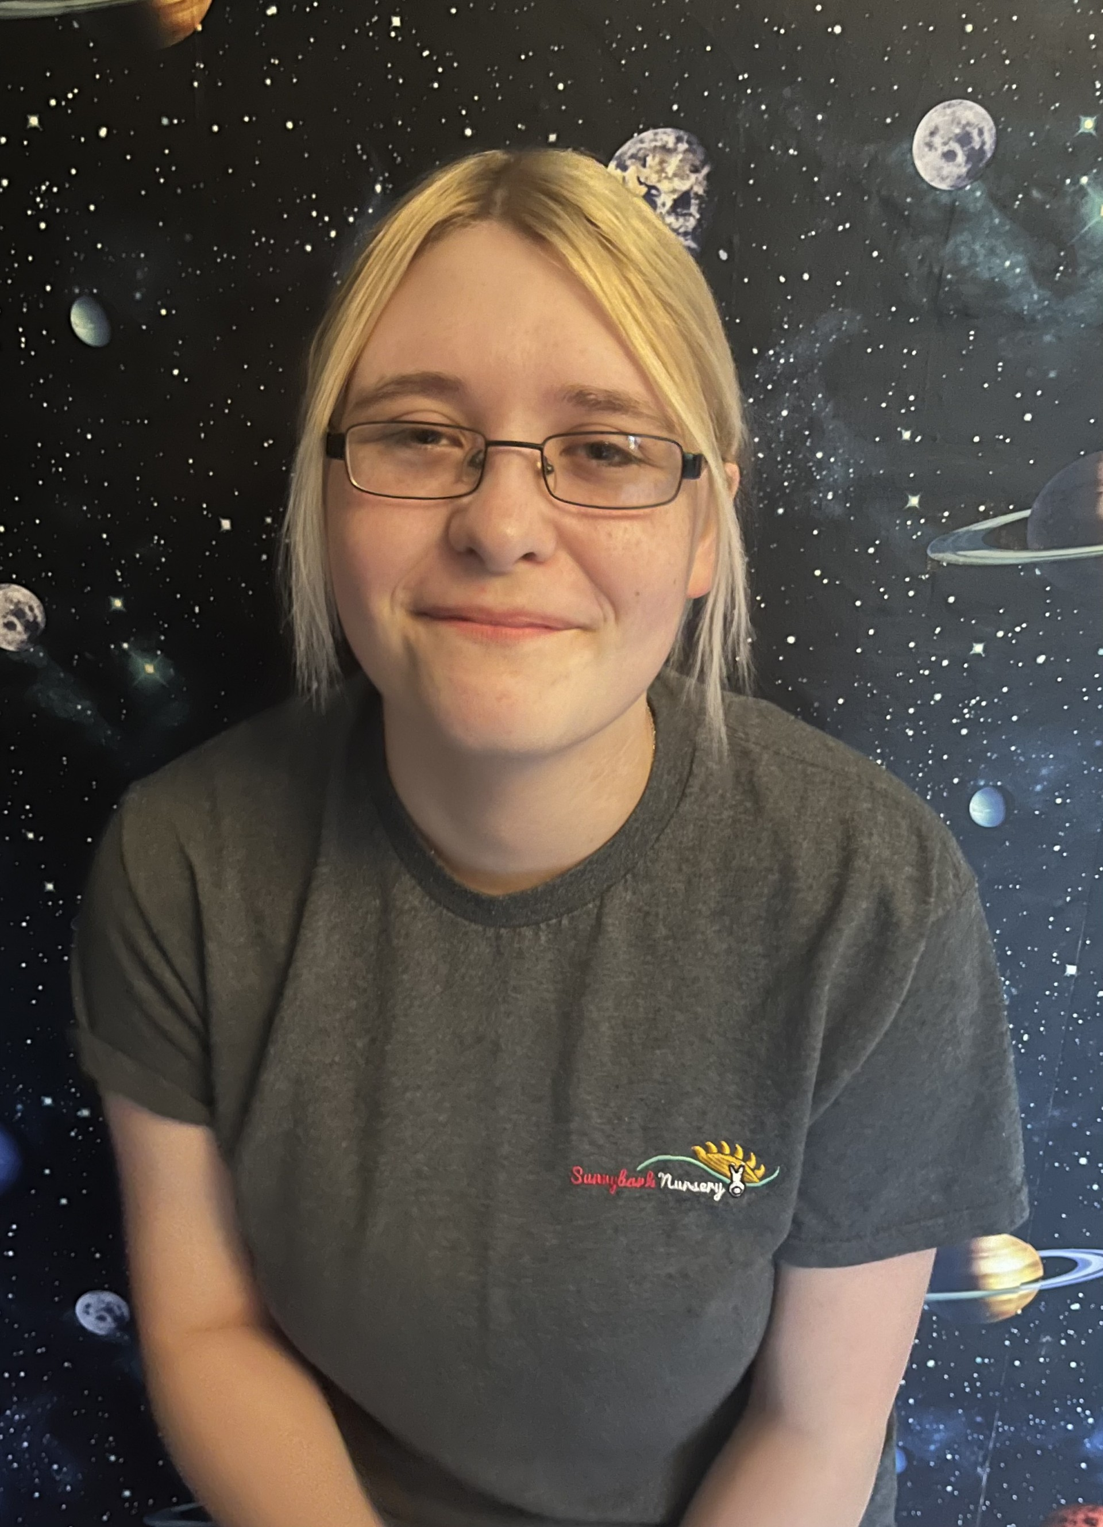
Staff Team - Rabbits
S
Taylor – Team Leader
Tamsin – Practitioner
Casey - Practitioner

Slide 6
Introduction
Established in 1993, Sunnybank Day Nursery has been a trusted and much-loved part of the local community for over three decades. Now proudly owned and led by Kelly and David Packwood, our vision is to continue the nursery’s long-standing tradition of providing a family-centred, nurturing, and inclusive environment where every child can thrive.
At Sunnybank, we believe that children flourish when they feel safe, valued, and at home. Our setting provides a warm and welcoming atmosphere that encourages curiosity, independence, and confidence. We are committed to maintaining the same caring, family dynamic that has made Sunnybank such a special place for generations of children and their families.
We take great pride in our high standards of care, our experienced and dedicated team, and the strong partnerships we build with parents and the wider community. Together, we create a positive, homely environment where children can grow, learn, and develop to their fullest potential.

Slide 7
Children as Individuals
We complete daily observations and diary entries for our Main Nursery children via our software app Tapestry. We like to share photographs, wow moments and learning with you so you have lots of exciting talking points at home.
We encourage you to share photographs and special moments back with us through the app so we can celebrate them in Nursery, such as family photographs in our home corner, special events such as birthdays so we can make pictures and cards or special achievements that we can display in our rooms and talk about.
Developing independence and confidence is the overall goal ready for our children being ready for the next step. We encourage independence through serving meals and snacks, activity choice, flexible routines and much more.

Slide 8
Assessment Schedule
A
OBSERVATIONS
We observe children daily and these will be posted to your child’s journal.
ASSESSMENTS
Your child will receive a written report at the end of each term via Tapestry.
PARENTS EVENINGS
Parents evenings will also be held at the end of each term to discuss your child’s progress and next steps. However, please do not feel the need to wait for these appointments, we encourage an ‘open door’ policy and are happy to discuss your child’s development each session.

Slide 9
Drop off and pick up
D
Our babies have their own private entrance at the very front of the building, whilst Minis and Rabbits use the main entrance door on the patio.
Please ring the bell and a member of staff will invite you in.

Slide 10
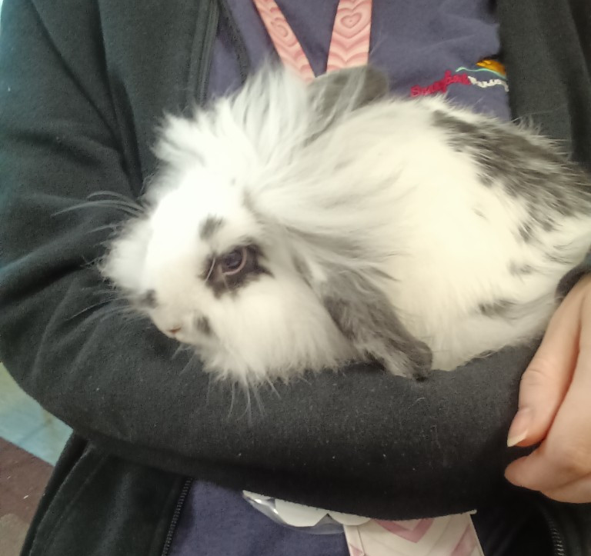
Pets in Nursery
Pets, living things and plants form a large portion of our pedagogy and curriculum, and the responsibilities within Nursery reflect the children’s capabilities at each stage.
In Babies and Minis, we have several cold-water fish. The children enjoy the sensory benefits of this along with beginning to recognize the need to feed them daily.
In Rabbits we have Neville the Giant African Land Snail. Neville provides the next stage in care, being able to hold, bathe and feed him daily.
Finally in preschool we have our beloved bunny, Dotty. Dotty is more versatile and provides the opportunity for children to expand their care skills through feeding, cleaning, washing, grooming, handling and walking her.

Slide 11
Important Information

Slide 12
Curriculum
We use the new Statutory Framework for the Early Years Foundation Stage (September 2021), along with the Development Matters guidance to support our curriculum planning. The curriculum is a broad and varying mixture of approaches (including but not limited to Elizabeth Jarmans Communication Friendly Spaces, HYGGE in the Early Years, Reggio, Montessori, Outdoor Learning and Forest Schooling), allowing us to tailor our approach for every child to allow them to reach their full potential. Each rooms individual curriculum is sequential and leads to a final aim of children being ready for school. These are displayed within rooms and on Tapestry for parents to view.

Slide 13
Going Home Bears
B
Throughout Nursery we have a number of going home bears, who may join you for the weekend! They come with some props and activity ideas and a diary. We encourage you to write about what you have been up to and add photographs where possible so we can share these during session times.

Slide 14
 | Autumn 1 | Autumn 2 | Spring 1 | Spring 2 | Summer 1 | Summer 2
Predictable Interests NB These themes will be adapted to allow children’s interests to underpin planning. | New Beginnings Superheroes People who help us Food Being kind / staying safe | Traditional Tales Our favourites Familiar tales Library visits Letters to Father Christmas | Animals around the world Down on the Farm Mini Beasts Animal patterns Dinosaurs and fossils | Plants & Flowers Weather / seasons The Sun and Moon Forest School Planting seeds Reduce, Reuse & Recycle Fun Science / Materials | Around the Town Fly me to the moon! Vehicles | Under the sea Off on holiday Send me a postcard! Seaside art
Possible Texts or Rhymes | Owl Babies Stick Man The Smartest Giant Rainbow Fish Big Book of Families | Goldilocks Farmer Duck The Ugly Duckling Christmas Story | The Very Hungry Caterpillar Tiger Who Came to Tea Pig in the Pond | Supertato Oliver’s Vegetables Jack and the Beanstalk Jasper’s Beanstalk | Snail and the Whale Bob, The Man on the Moon | Lighthouse Keepers Lunch Tiddler World Atlases
Enrichment Opportunities | Autumn Trail Fire Station Visit Harvest Festival Halloween | Bonfire Night Christmas Diwali Remembrance day Children in Need | Zoo Lab Chinese New Year Valentines Day | Trips Easter Mothers Day | Road Safety Post a Letter Food tasting | World Space Week Fathers Day Pirate Day

Slide 15
Daily Routine
Each day in nursery is different to the last and we place emphasis on following children’s individual needs and routines as well as their interests and next steps. However, a sample day would follow:
7:00 - 9:30 breakfast and free play
9:30 - 10:00 group time and singing/toothbrushing
10:00 - 10:30 rolling snack available
10:30 - 11:15 outdoor
11:30 - 12:30 lunch time
12:30 - 1:30 - rest and free play activities
1:30- 2:00 – group time and story time
2:00 - 2:30 snack
2:30 - 3.15 outdoor
3:30 - 4:00 teatime
4:00 – 6:00 outdoor/free play

Slide 16
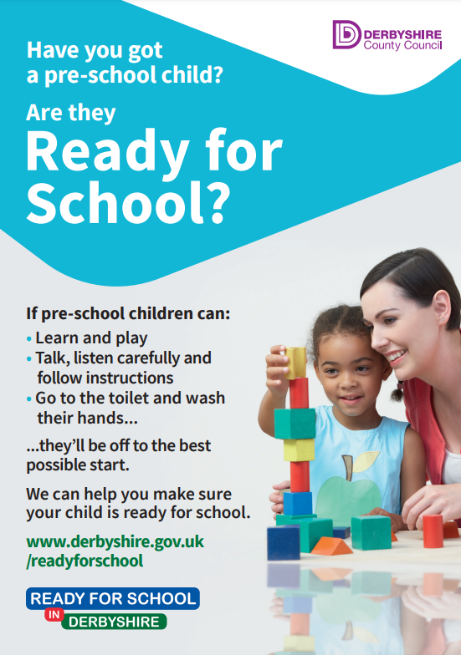
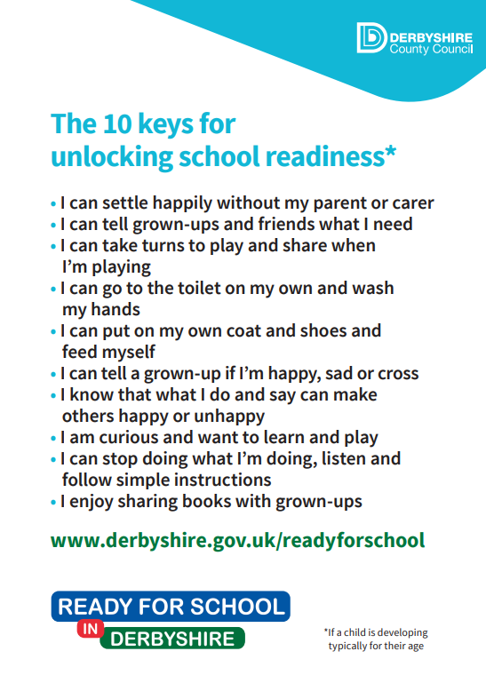
10 Keys to School Readiness

Slide 17
Parent Partnerships
P
We value greatly the relationships we have with our families, and this doesn’t change in pre-school. We hold lots of curricular activities that you are invited to join in with including Forest schools, stay and plays and much more.
Equally we value and support your input in your child’s journey at Sunnybank, so any ideas you may have are appreciated and welcomed.
Please keep an eye out for information on these events on monthly newsletters and join us where you can!

Slide 18

Useful Resources
https://www.bbc.co.uk/tiny-happy-people
https://hungrylittleminds.campaign.gov.uk/
https://www.twinkl.co.uk/
https://www.derbyshire.gov.uk/leisure/libraries/find-your-local-library/chesterfield-library.aspx
https://foundationyears.org.uk/files/2015/03/4Children_ParentsGuide_2015_WEB.pdf
https://www.localoffer.derbyshire.gov.uk/home.aspx
https://abcdoes.com/
https://www.gov.uk/government/publications/development-matters--2

Slide 19
Thank you
SUNNYBANK NURSERY
07704884344
Officeteam.sunnybankdaynursery@gmail.com

